Slide 1
Linked List, its types, Sorted Linked List, and Working of Arrays
By
Adnan Majeed
Lecturer , CS, Leads University , GCU

Slide 2
Linked List and Arrays in Python
1. Introduction to Linked List
A Linked List is a linear data structure in which elements (called nodes) are connected using pointers. Unlike arrays, linked lists do not store elements in contiguous memory locations.
📙 Structure of a Node
Each node consists of:
Data: The actual value or information.
Next: A pointer/reference to the next node in the list.

Slide 3
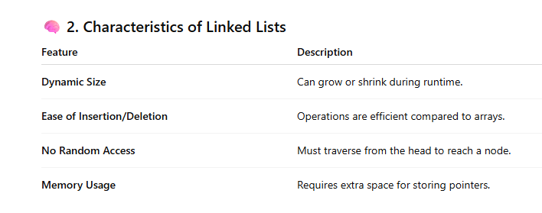
2. Characteristics of Linked Lists

Slide 4
Types of Linked Lists
3.1 Singly Linked List
Each node points to the next node, and the last node points to None.
Structure:
Head → [Data|Next] → [Data|Next] → None

Slide 5
class Node:
def __init__(self, data):
self.data = data
self.next = None
class SinglyLinkedList:
def __init__(self):
self.head = None
def append(self, data):
new_node = Node(data)
if not self.head:
self.head = new_node
return

Slide 6
temp = self.head
while temp.next:
temp = temp.next
temp.next = new_node
def display(self):
temp = self.head
while temp:
print(temp.data, end=" → ")
temp = temp.next
print("None")
# Example Usage
ll = SinglyLinkedList()
ll.append(10)
ll.append(20)
ll.append(30)
ll.display()

Slide 7
Output
10 → 20 → 30 → None

Slide 8
Doubly Linked List
Each node contains pointers to both the next and previous nodes.
Structure:
None ← [Prev|Data|Next] ↔ [Prev|Data|Next] → None

Slide 9
class Node:
def __init__(self, data):
self.data = data
self.next = None
self.prev = None
class DoublyLinkedList:
def __init__(self):
self.head = None
def append(self, data):
new_node = Node(data)
if not self.head:
self.head = new_node
return

Slide 10
temp = self.head
while temp.next:
temp = temp.next
temp.next = new_node
new_node.prev = temp
def display_forward(self):
temp = self.head
while temp:
print(temp.data, end=" ↔ ")
temp = temp.next
print("None")
# Example Usage
dll = DoublyLinkedList()
dll.append(5)
dll.append(15)
dll.append(25)
dll.display_forward()

Slide 11
Circular Linked List
The last node points back to the first node, forming a circle.
Structure:
Head → [Data|Next] → [Data|Next] → [Data|Next] ┐
└──────────────────────────────────────┘

Slide 12
class Node:
def __init__(self, data):
self.data = data
self.next = None
class CircularLinkedList:
def __init__(self):
self.head = None
def append(self, data):
new_node = Node(data)
if not self.head:
self.head = new_node
new_node.next = self.head
return
temp = self.head
while temp.next != self.head:
temp = temp.next

Slide 13
temp.next = new_node
new_node.next = self.head
def display(self):
temp = self.head
if not self.head:
return
while True:
print(temp.data, end=" → ")
temp = temp.next
if temp == self.head:
break
print("(head)")

Slide 14
Sorted Linked List
A sorted linked list maintains elements in ascending order automatically upon insertion.

Slide 15
class Node:
def __init__(self, data):
self.data = data
self.next = None
class SortedLinkedList:
def __init__(self):
self.head = None
def insert_sorted(self, data):
new_node = Node(data)
if not self.head or data < self.head.data:
new_node.next = self.head
self.head = new_node
return
temp = self.head
while temp.next and temp.next.data < data:
temp = temp.next
new_node.next = temp.next
temp.next = new_node

Slide 16
def display(self):
temp = self.head
while temp:
print(temp.data, end=" → ")
temp = temp.next
print("None")
# Example Usage
sll = SortedLinkedList()
for val in [30, 10, 20, 5, 25]:
sll.insert_sorted(val)
sll.display()

Slide 17
Output
5 → 10 → 20 → 25 → 30 → None

Slide 18
Arrays in Python
An array is a collection of items stored at contiguous memory locations.
Python does not have a built-in array data structure like C or Java, but we can use:
Lists (built-in)
array module

Slide 19
Example using Python List
arr = [10, 20, 30, 40]
print("Array Elements:", arr)
# Access
print("First Element:", arr[0])
# Insertion
arr.append(50)
# Deletion
arr.remove(20)
# Traversal
for i in arr:
print(i, end=" ")

Slide 20
Example using array Module
import array
arr = array.array('i', [1, 2, 3, 4, 5])
print("Original Array:", arr.tolist())
arr.append(6)
arr.insert(2, 9)
arr.remove(3)
print("Modified Array:", arr.tolist())

Slide 21
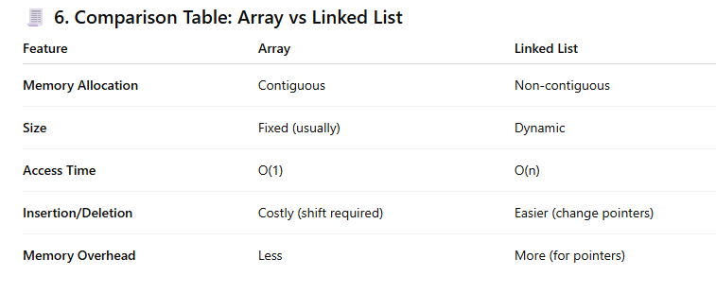

Slide 22
7. Summary
Linked List is a linear structure made up of nodes connected via pointers.
Types: Singly, Doubly, Circular, and Sorted Linked List.
Sorted Linked List maintains ascending order automatically.
Arrays store elements in contiguous memory with fixed size but allow faster access.

